Slide 1

Google App Engine Tutorial
Joe Gregorio
Developer Advocate
Google App Engine
Joe Gregorio
Developer Advocate
Google App Engine

Slide 2
Memcache
  Fast

Slide 3
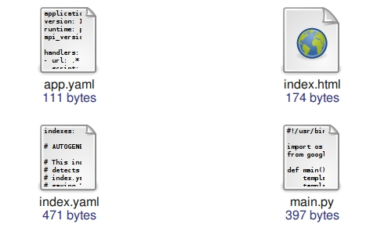
The contents of tutorial10

Slide 4
main.py
from google.appengine.api import memcache
import logging
...
class IndexHandler(webapp.RequestHandler):
def get(self):
body = memcache.get("index")
if body is None:
items = ToDoModel.all().order("-created").fetch(100)
count = ItemCount.get_or_insert("created_items")
template_values = {"items": items, "total": count.total }
template_file = os.path.join(os.path.dirname(__file__),
"index.html")
body = template.render(template_file, template_values)
memcache.add("index", body)
else:
logging.info("Memcache hit!")
self.response.out.write(body)
def post(self):
memcache.delete("index")
description = self.request.get("description")
...

Slide 5
Retrieve body from memcache
from google.appengine.api import memcache
import logging
...
class IndexHandler(webapp.RequestHandler):
def get(self):
body = memcache.get("index")
if body is None:
items = ToDoModel.all().order("-created").fetch(100)
count = ItemCount.get_or_insert("created_items")
template_values = {"items": items, "total": count.total }
template_file = os.path.join(os.path.dirname(__file__),
"index.html")
body = template.render(template_file, template_values)
memcache.add("index", body)
else:
logging.info("Memcache hit!")
self.response.out.write(body)
def post(self):
memcache.delete("index")
description = self.request.get("description")
...

Slide 6
Add to memcache if it is missing
from google.appengine.api import memcache
import logging
...
class IndexHandler(webapp.RequestHandler):
def get(self):
body = memcache.get("index")
if body is None:
items = ToDoModel.all().order("-created").fetch(100)
count = ItemCount.get_or_insert("created_items")
template_values = {"items": items, "total": count.total }
template_file = os.path.join(os.path.dirname(__file__),
"index.html")
body = template.render(template_file, template_values)
memcache.add("index", body)
else:
logging.info("Memcache hit!")
self.response.out.write(body)
def post(self):
memcache.delete("index")
description = self.request.get("description")
...

Slide 7
Clear the cache if we change the underlying data
from google.appengine.api import memcache
import logging
...
class IndexHandler(webapp.RequestHandler):
def get(self):
body = memcache.get("index")
if body is None:
items = ToDoModel.all().order("-created").fetch(100)
count = ItemCount.get_or_insert("created_items")
template_values = {"items": items, "total": count.total }
template_file = os.path.join(os.path.dirname(__file__),
"index.html")
body = template.render(template_file, template_values)
memcache.add("index", body)
else:
logging.info("Memcache hit!")
self.response.out.write(body)
def post(self):
memcache.delete("index")
description = self.request.get("description")
...

Slide 8
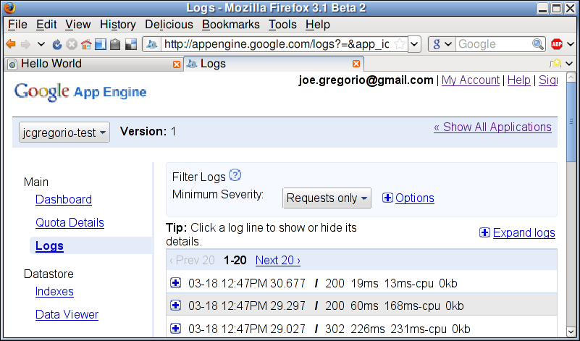
Dashboard
Request latency down from 60ms to 19ms and CPU used down from 168ms to 13ms.

Slide 9
Notes
Program defensively
Cache may get flushed at any time
Atomic Increment and Decrement
You can add memcache at different points

Slide 10
Practice
Use Memcache to speed up ItemCount
Use memcache.incr() to keep cache value
up to date
What if cache is flushed?

Slide 11
Thank You
  Questions?

